Slide 1
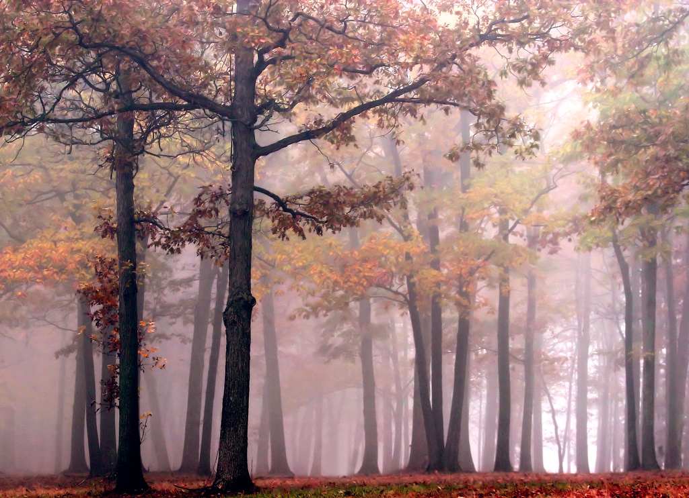
NS3310 - Physical Science Studies
History of Life On Earth

Slide 2
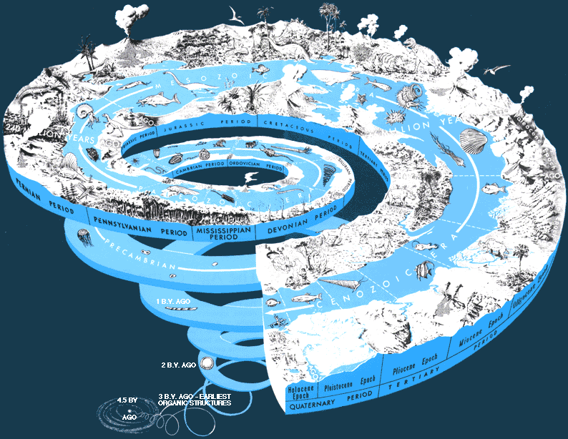
Geologic Time
Relative Time
Law of Superposition
Uniformitarianism
Unconformities
Absolute Time
Radiometric Datine

Slide 3
Earth History

Slide 4
Hopscotch Through Geologic Time

Slide 5
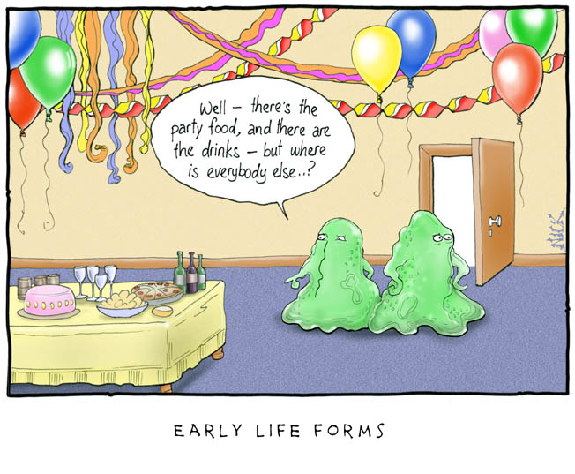
Paleobiology – The History of Life
Origin of Life
Evolution of Life

Slide 6
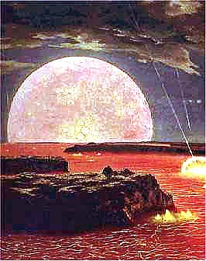
Hadean (4.5 to 3.96 bya)
Earth accreted from bolides.
Material differentiated into core, mantle, crust and atmosphere
Hostile conditions.
Early crust formation (detrital zircon grains dating to 4.2 bya found in sedimentary rocks), but no rocks still exist in the geologic record.

Slide 7
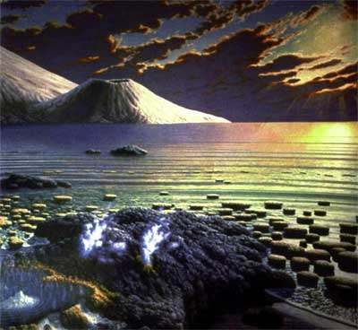
Archaen (3.96 to 2.5 bya)
Cratons form (continental accretion).
Early atmosphere (outgassing).
First organisms (3.3 to 3.5 bya)
Origin of life? once there
is a self-replicating
molecule, there is
natural selection
Extremophiles
Stromatolites

Slide 8
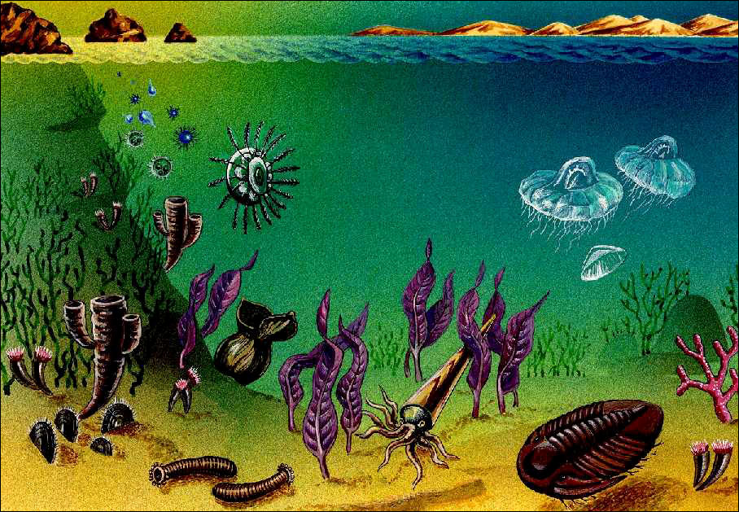
Proterozoic (2.5 to 0.54 bya)
Transition from Archaen type crustal evolution to current pattern of tectonic cycle.
Laurentia
Orogeny
Wilson cycles
Banded iron formations
(red beds)

Slide 9
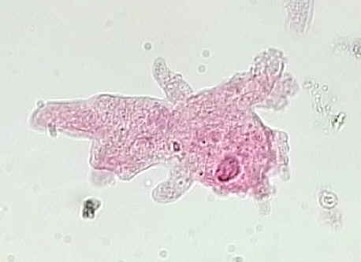
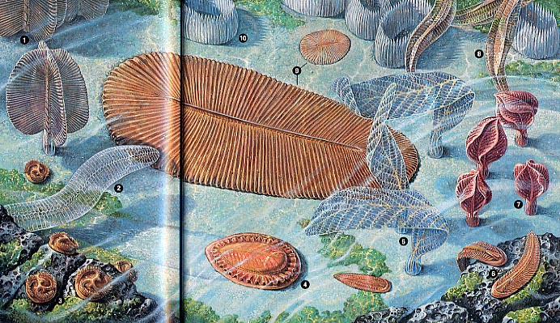
Prokaryototes (3.3 to 3.8 bya?) Photosynthesis (2.3 bya?) Eukaryotes (2.1 bya?) endosymbiosis sexual reproduction multicelled organisms Ediacaran fauna Snowball earth? Early invertebrates? Ozone

Slide 10
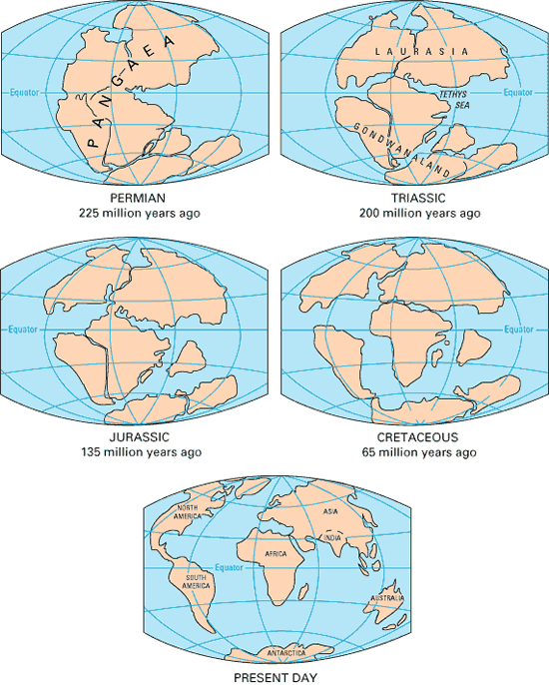
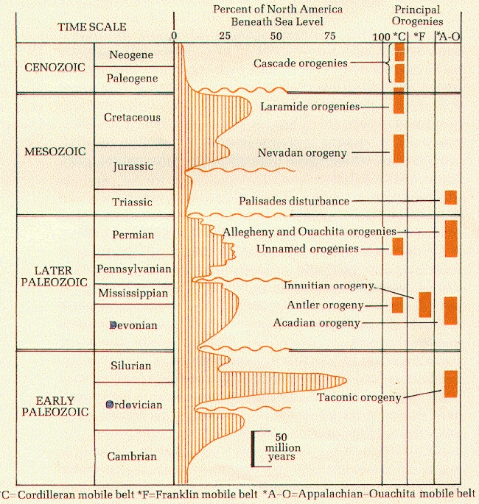
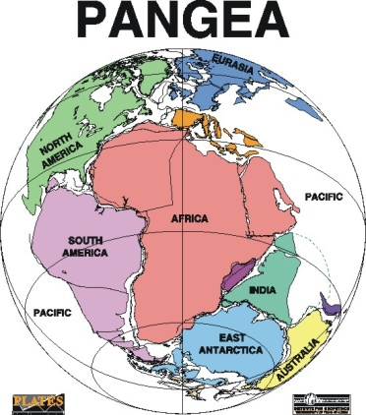
Tectonic History

Slide 11
Mass Extinctions
End of the Permian
Anoxia
Flood basalts
Volcanism
K/T
Bolide impact

Slide 12
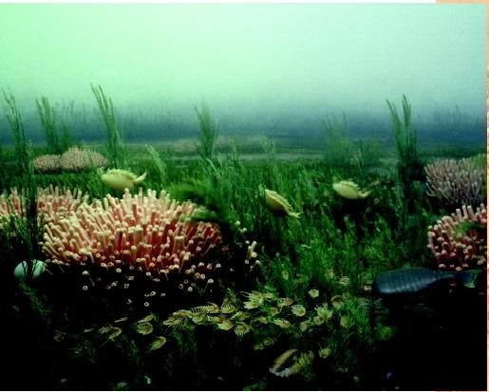
Cambrian Explosion (545 mya)
Emergence of shelley fauna
Marine ecosystem
benthos
epifauna
infauna
plankton
nekton
near shore (neritic)
deep water (pelagic)
Trophic levels - PREDATION!

Slide 13
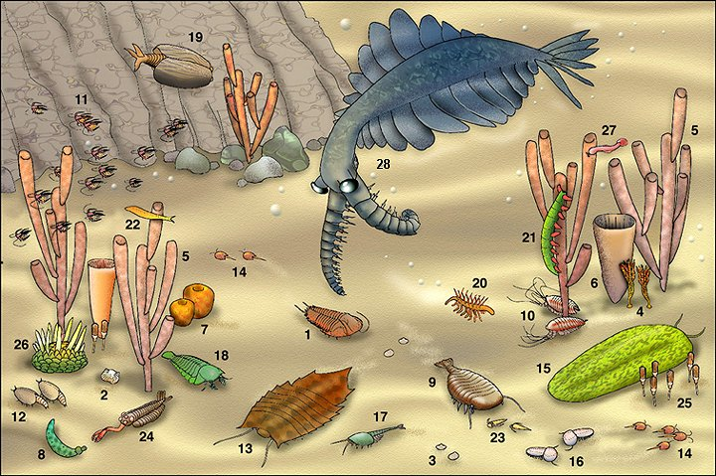
Burgess Shale
Experimentation of body plans
Wiwaxia (mollusca)
Hallucigenia (polychaete)
Ottoia (annelid)
Trilobites (arthropods)
Brachiopods - chitinous, inarticulated
Archaeocyathids (reef building)
Echinoderms
(jawless fish - ostracoderms)

Slide 14
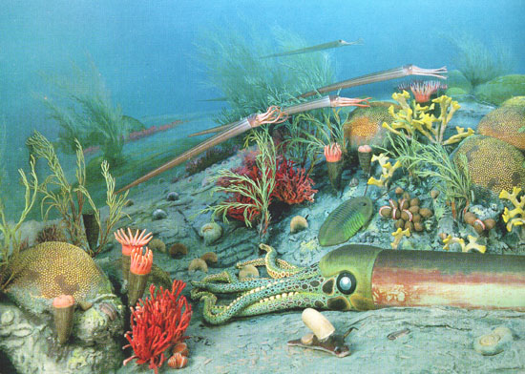
Ordovician
Acritarchs (phytoplankton)
Graptolites (zooplankton)
Conodonts (early chordata)
Mass extinction
glaciation ?
(ostracoderms, first land plants, first land animals)

Slide 15
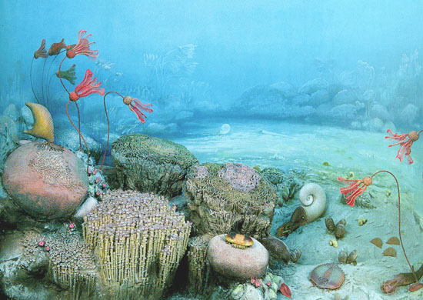
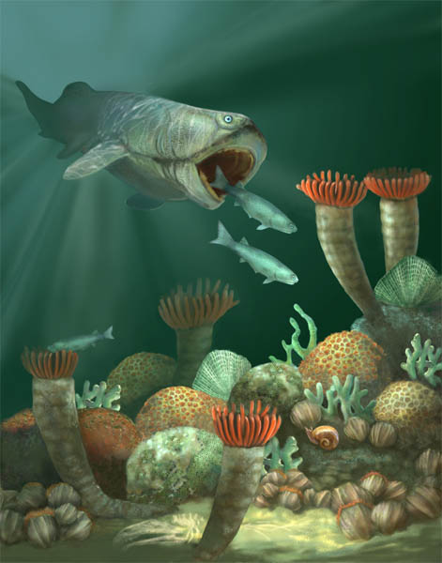
Silurian and Devonian
Major reef building
tabulate and rugose coral
Eurypterids (arthropods)
Ammonites (mollusca - cephalapoda)
Devonian mass extinction
reef and pelagic communities
(age of fishes, first jawed fish, first
amphibians, first seed plants)

Slide 16
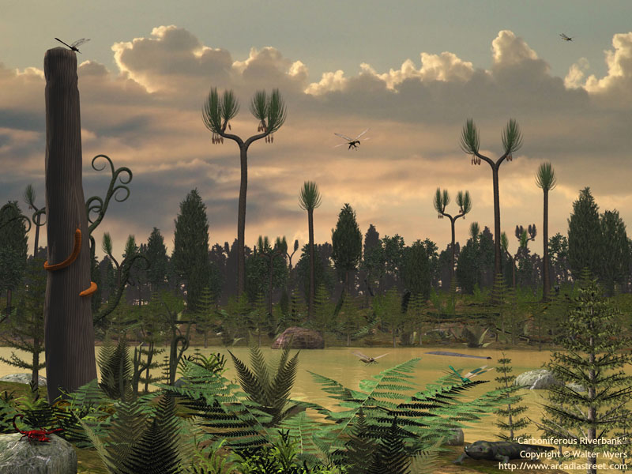
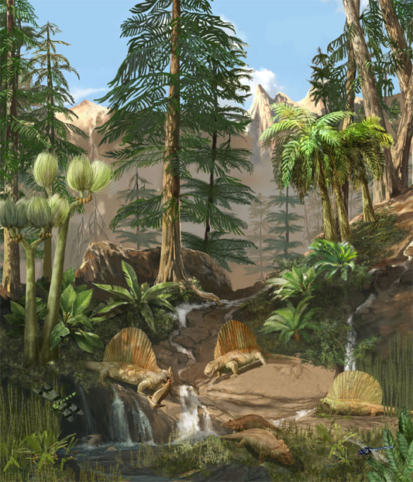
Carboniferous and Permian
Patch reefs
Lacy Bryozoans
Crinoids
Blastoids
Brachiopods
productids
Foraminifera
fusulinids
Insects
(first reptiles, first gymnosperms)

Slide 17
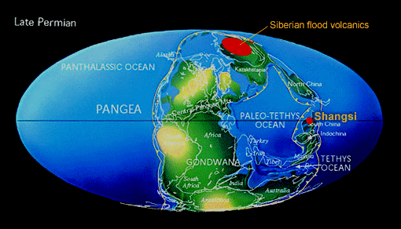
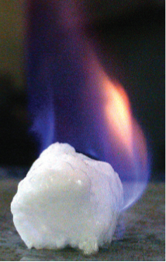
Permian Mass Extinction
50% marine vertebrates
90% marine invertebrates
Widespread marine regression
Anoxia
Methyl hydrates ?
Ocean turnover ?
Flood basalts ?
Siberian traps

Slide 18
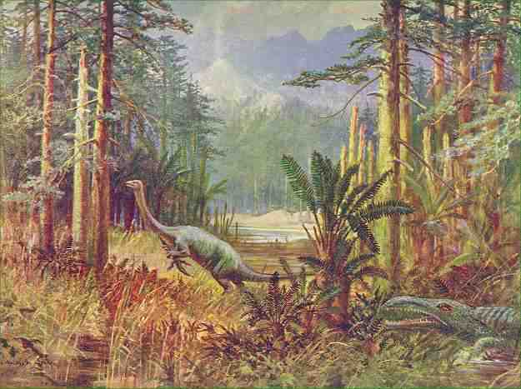
Mesozoic
Mollusca
gastropods
bivalves
cephalopods
Coral
scleractinians
Rudists (main reef builders)
Echinoids
epifaunal and infaunal
Coccolithiphorids
Diatoms
Dinoflagellates
Foraminifera
Radolaria
(all major vertebrate groups, angiosperms)

Slide 19
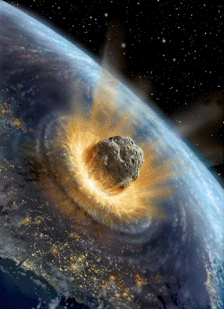
K/T Mass Extinction Event
75% of marine organisms
including ammonites, rudists, marine reptiles)
Bolide impact (Chicxulub crater)
iridium anomaly
shocked quartz
clay layer
soot layer
nuclear winter ?
Flood basalts
deccan traps
Climatic boundary conditions

Slide 20
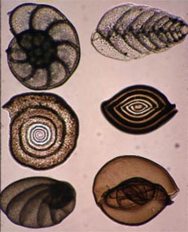
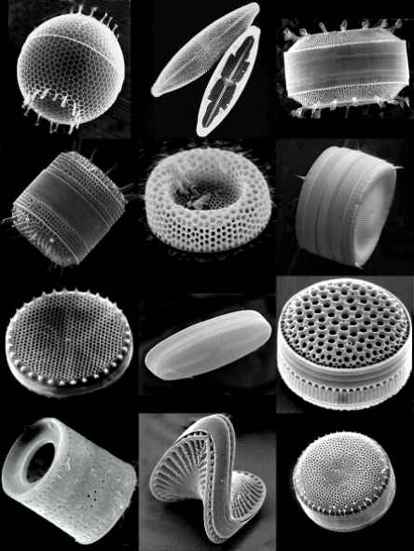
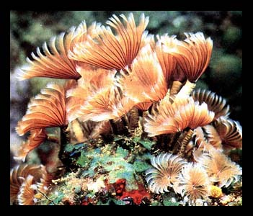
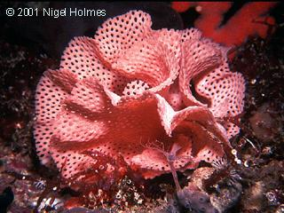
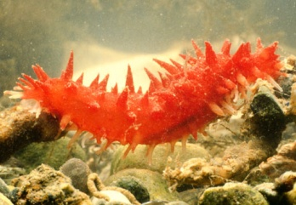
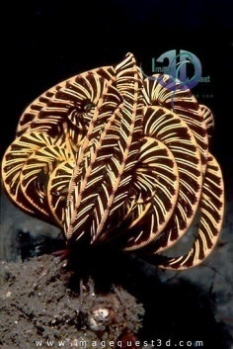
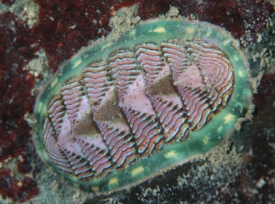
Cenozoic
Foraminifera Diatoms
Thecamoebans Dinoflagellates
Radiolarians Coccolithophorids
Nannoplankton
Corals Porifera
Coelenterata Annelida
Platyhelmenthes Polychaeta
Nematoda Bryozoa
Mollusca
Arthropods Echinoids
insects
arachnids
decapoda
crustacea
isopods

Slide 21
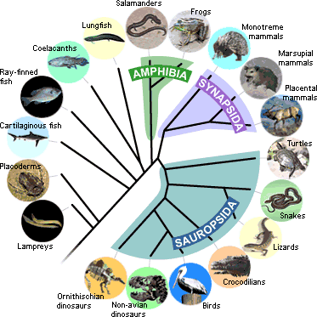
Vertebrates
Cyclostomes – lampreys and hagfishes
Ostracoderms – primitive armored fishes (freshwater?)
Acanthodians – first jawed vertebrates
Chondrichtyes – cartilagenous fishes
Osteichthyes – bony fishes
Lobe finned fishes
Ray finned fishes

Slide 22
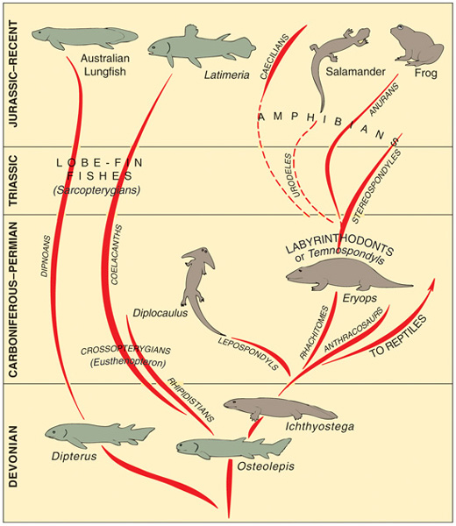
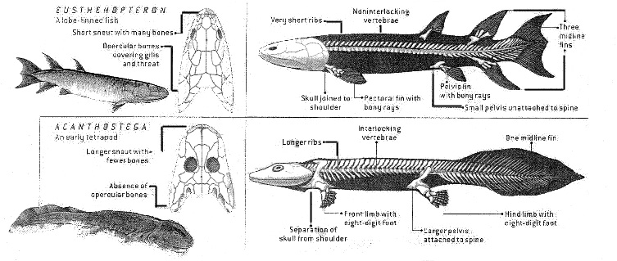
Amphibians
Crossopterygians
Labyrinthodonts
Anura
Urodela
Apoda
Adaptations to land
Reproductive
Skelatal
behavioral

Slide 23
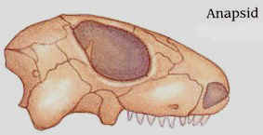
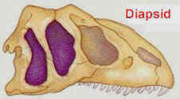
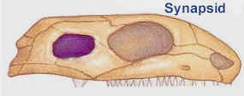
Early Reptiles
Further adaptations to land
Girdles
Shelled eggs
Skull
Stem reptiles (protorothyrids)
Euryapsida (sauropterygians - plesiosaurs)
Mesosauria (aquatic)
Ichthyopterydia (ichthyosaurs – fish reptiles)
Anapsida (chelonians – turtles)
Lepidosauria (eosuchians – ancestors of squamata (lizards and snakes))
Synapsida (mammal-like reptiles, dimetrodon, cynodonts)

Slide 24
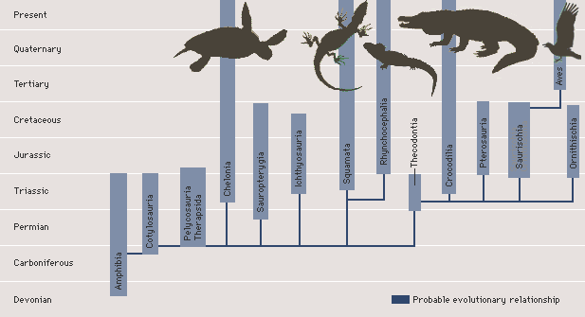
Archosauria (Ruling Reptiles)
Crocodilia
Pterosauria (flying reptiles)
Saurischia
Bipedal dinosaurs
Theropods
Sauropods
Birds
Ornithischia
Quadrapedal dinosaurs
Stegosaur
Ankylosaur
Ornithopod
Pachycephalosaur
ceratopsia

Slide 25
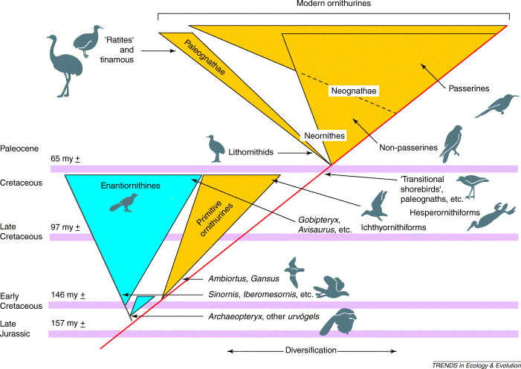
Birds (Aves)
Major adaptations
Feathers (?)
Flight
Thermoregulation (?)
Orders
Gaviiformes (loons)
Podicipediformes (grebes)
Procellariiformes (petrels, albatross)
Sphenisciformes (penguins)
Pelecaniformes (pelicans, cormorants,
frigate birds)
Ciconiiformes (herons, storks, flamingos)
Anseriformes (ducks, geese, swans)
Falconiformes (birds of prey)
Galliformes (fowls)
Ralliformes (cranes, rails)
Diatrymiformes (diatryma)
Charadriiformes (gulls, terns, auks)
Ichthyornithiformes (ichthyornis)
Columbiformes (doves and pigeons)
Psittaciformes (parrots)
Cuculiformes (cuckoos and road runners)
Strigiformes (owls)
Caprimulgiformes (oilbirds, goatsuckers, whippoorwill)
Apodiformes (hummingbirds)
Coliiformes (mousebirds)
Coraciiformes (kingfishers, hornbills)
Piciformes (woodpeckers)
Passeriformes (perching birds)

Slide 26
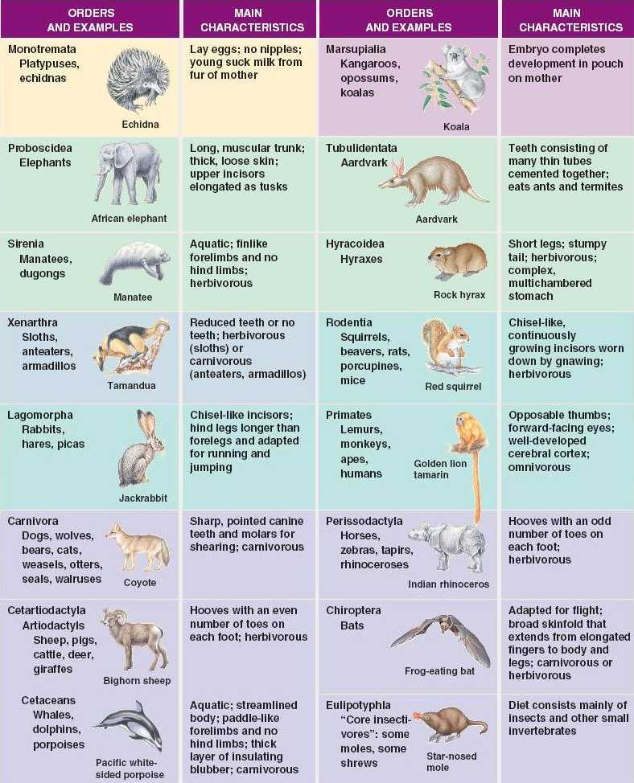
Mammals
Major adaptations
Hair
Live birth
Parental investment (?)
Monotremes (prototheria)
Marsupials (metatheria)
Placentals (eutheria)

Slide 27
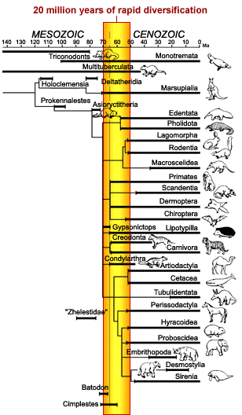
Placental Orders
Insectivora (shrews, hedgehogs, moles)
Chiroptera (bats)
Dermoptera (flying lemurs)
Carnivora (dogs, wolves, cats, bears, weasels)
Creodonts
Miacids
Tubulidentata (aardvark)
Rodentia (squirrels, rats, woodchucks)
Pholidota (pangolins)
Lagomorpha (rabbits, hares, pikas)
Edentata (sloths, anteaters, armadillos)
Cetacea (whales, dolphins, porpoises)
Proboscidea (elephants, mammoths)
Hyracoidea (hyraxes)
Sirenea (manatees)
Perissodactyla (odd-toed ungulates – horses, zebras, tapirs, rhinos)
Artiodactyla (even-toead ungulates – swine, camels, deer, hippos, antelopes, cattle, sheep, goats)
Primates (lemurs, monkeys, apes, humans)
Creodonta (primitive carnivorous mammals)
Palaeoryctoids (shrew-like mammals)
Condylarthra (ancestral ungulates)
Embrithopoda (subungulates)
Desmostylia

Slide 28
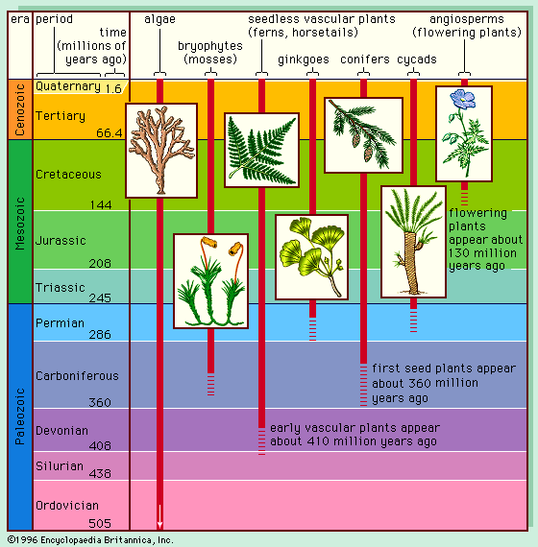
Plants
Division Anthocerophyta (Hornworts)
Division Bryophyta (Mosses)
Division Hepatophyta (Liverworts – first land plants – first true plants)
Division Lycophyta (Club Mosses – first vascular plants)
Division Sphenophyta (horsetails)
Division Psilophyta (Whisk Ferns – primitive vascular plants, possibly reduced from previous fern-like ancestors)
Division Pterophyta (Ferns)
Division Cycadophyta (Cycads)
Division Ginkgophyta (Ginkos)
Division Coniferophyta (Conifers)
Division Gnetophyta (vessel-bearing gymnosperms, ancestral to flowering plants)
Division Anthophyta (Flowering Plants)

Slide 29
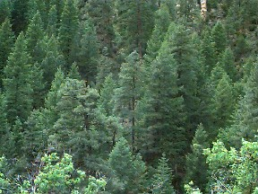
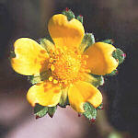
Plant Adaptations
Reproduction/Life cycles
From slime molds to mosses
Spores
Seeds
Gymnosperms
Angiosperms
Food and water transport
Non-vascular plants
Vascular plants
Monocots
dicots

Slide 30
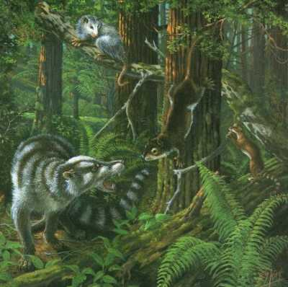
Plant – Animal Interactions
Biomes
Photosynthesis/Respiration
(the carbon cycle)
Trophic levels (energetics)
Avoidance strategies
Reproductive strategies (vectors)

Slide 31
Key Concepts
The earth is 4.5 billion years old
The present is the key to the past
Geologic time is divided into Eons, Eras, Periods, Epochs and Ages
The Phanerazoic Eon is divided into three Eras, the Paleozoic, Mesozoic and Cenozoic
Studying rocks and the fossil record takes us on a Hopscotch Through Geologic Time

