Slide 1
NS3310 – Physical Science Studies
Chemical Reactions

Slide 2
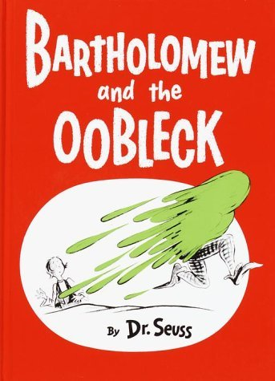
More Kitchen Chemistry
Let’s make Oobleck
Let’s make Gak

Slide 3
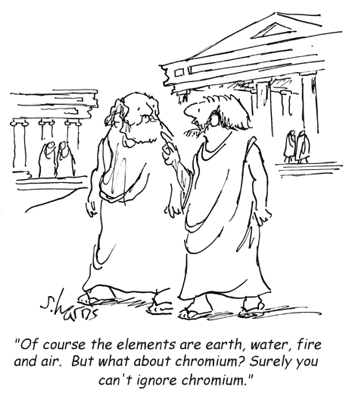
Key Questions
How do chemical bonds form molecules?
What are ionic bonds?
What are covalent bonds?
How do compounds with each type of bond
behave?
What is a chemical reaction?
What are acid-base reactions?
What are oxidation-reduction reactions?
How can we keep track of the reactants and products in a chemical reaction?

Slide 4
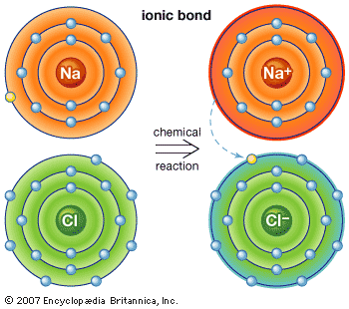
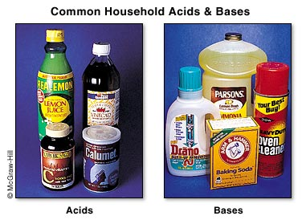
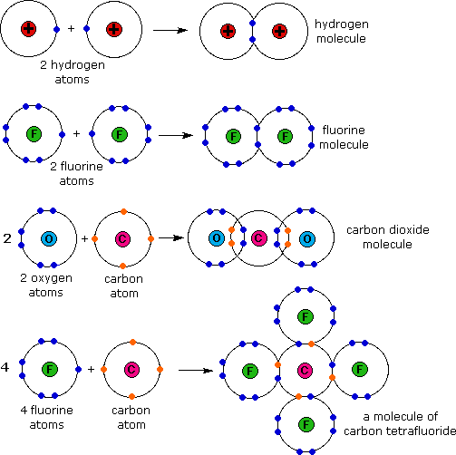
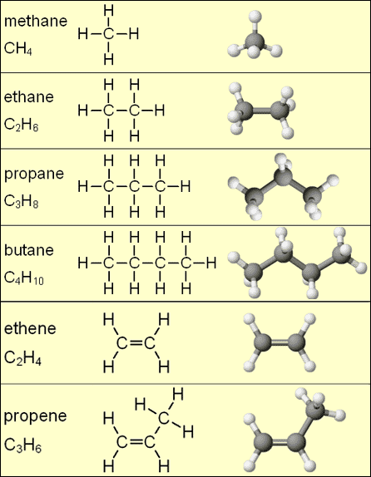
Chemical Bonds
Ionic
Covalent

Slide 5
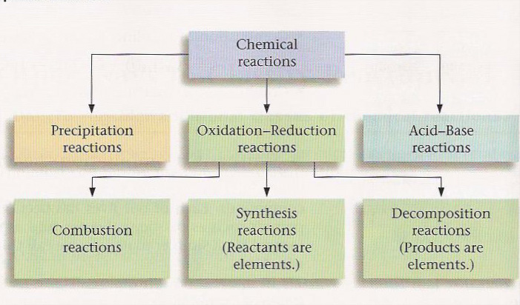
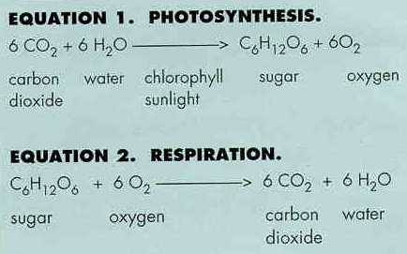
Chemical Reactions
Precipitation Reactions
Redox Reactions
Acid-Base Reactions

Slide 6
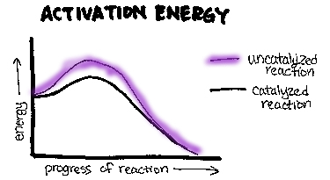
Activation Energy
Activation energy is often needed for a chemical reaction to occur
Catalyst

Slide 7
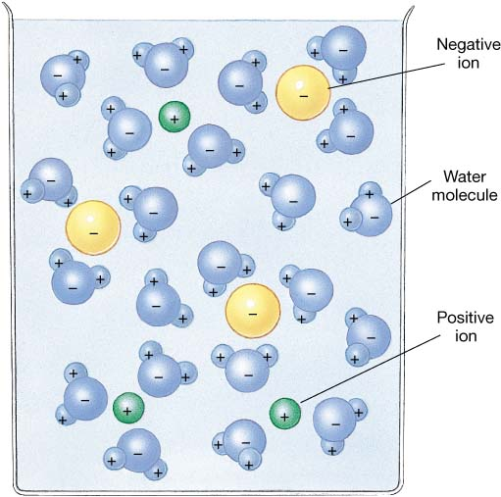
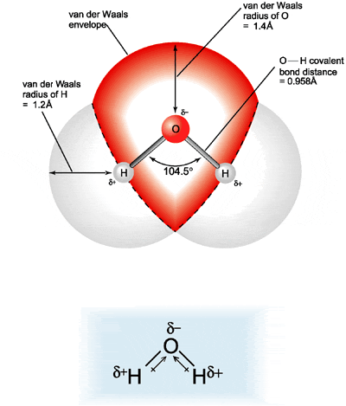
Solutions
Solvent
Solute
Water is the universal solvent

Slide 8
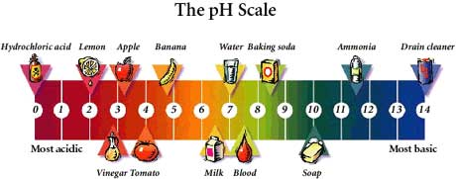
pH
H⁺ ion concentration
Buffer
Carbonate buffering system
Ocean water
blood
CO_{2(gas)} -> CO_{2(aqueous)}
H₂O_{(liquid)} + CO_{2(aqueous)} -> H₂CO_{3(aqueous)}
H₂CO_{3(aqueous)} -> HCO₃⁻_{(aqueous)} + H⁺_{(aqueous)}
HCO₃⁻_{(aqueous)} -> CO₃²⁻_{(aqueous)} + H⁺_{(aqueous)}

Slide 9
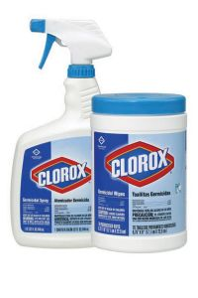
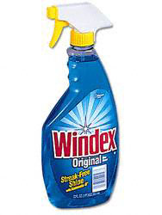
Why You Should Never Mix Ammonia and Bleach
Chlorine Gas (Cl2)
2(parts)NaOCl + 2NH3 --> 2NaONH3 + Cl2. (chlorine gas is toxic!)
Nitrogen Trichloride (NCl3) (NCl3 is explosive!)
3NaOCl + NH3 --> 3NaOH + NCl3
Hydrazine (N2H4) (Hydrazine is rocket fuel!)
NH3 + NaOCl --> NaOH + NH2Cl.
These two products then react with ammonia as follows:
NH3 + NH2Cl + NaOH -->N2H4 + NaCl + H2O.
One last reaction occurs to stabilise the reagents:
2NH2Cl + N2H4 --> 2 NH4Cl + N2.

Slide 10
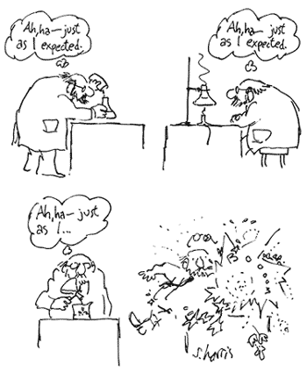
Key Concepts
Compounds can be formed through ionic or covalent bonding
Ionic bonds will break in water to form a solution
This can lead to reactions that rearrange ions
These types of reactions are called acid-base reactions
Covalent bonds will not dissolve in water, but can react chemically in oxidation-reduction reactions.

