Slide 1
NS3310: Physical Science Studies
Dr. Hoge

Slide 2
Four Levels of Climate Change
Detecting a Directional Change in the Global Climate.
Attributing Climate Change to Anthropogenic or Natural Causes.
Modeling Future Climate to Determine the Degree of Changes.
Responding to Climate Change Predictions.

Slide 3
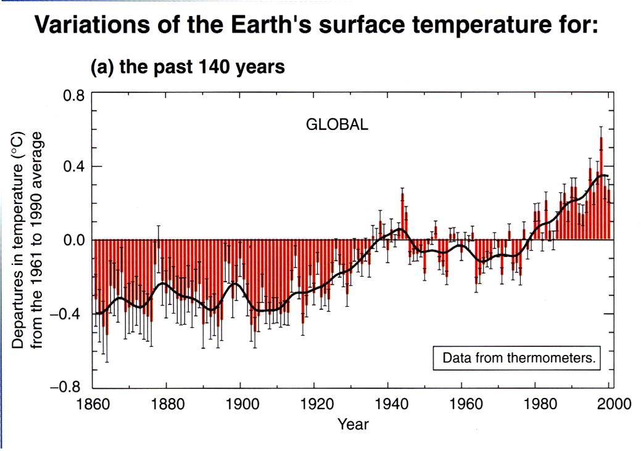
“I don’t think the weather has changed. Some of my students were at a conference where they had a debate. And they learned that there is scientific evidence to show that the earth is not warming. In fact it is cooling. We go through cycles, but sometimes people have short memories”— a high school principal to John Immerwahr.

Slide 4
One can also observe that the concentration of carbon dioxide in the atmosphere and the mean annual global temperature have been increasing since the end of the last ice age approximately 10,000 years ago.
Figure 4. CO2 Concentration. The Clinton White House from Neftel et al & Keeling

Slide 5
Through the study of ancient ice cores from Antarctica both the concentration of carbon dioxide in the atmosphere and Global Mean Annual Temperature can be determined for the past 160 thousand years of the earth's history.
Figure 3. CO2 and Temperature. The Clinton White House from Barnola et al., Vostok Ice Core

Slide 6
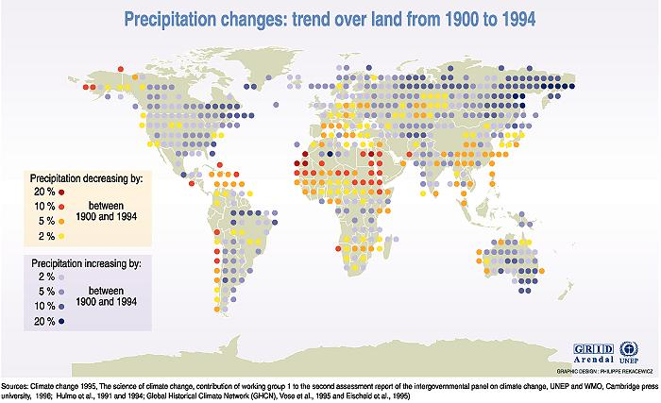
Global Carbon Cycle
From "Energy Futures" - a publication of the Natural Resources Defense Council and Uncommon Sense, Inc.

Slide 7
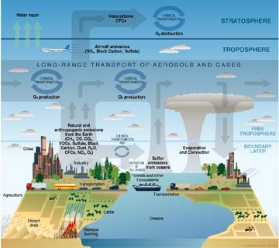
The global carbon cycle involves the earth's atmosphere, fossil fuels, the oceans, and the vegetation and soils of the earth's terrestrial ecosystems.
From Richard Houghton, Senior Scientist, Carbon Research, Woods Hole Oceanographic Institute

Slide 8
The dramatic increase in carbon dioxide concentration in the atmosphere over the past 150 years (from about 280 parts per million to about 360 parts per million) is largely due to anthropogenic (human-caused) effects (IPCC 1995).
The increase in atmospheric CO2 corresponds to annual fossil fuel emissions.

Slide 9
If carbon dioxide emissions continue to increase at present rates, a quadrupling of pre-industrial CO2 concentration will occur not long after the year 2100.
Projected temperature increases for such an atmospheric concentration are 15-20 °F above the present day mean annual global surface temperature.

Slide 10
If CO2 emissions are stabilized at current levels:
Surface temperatures are projected to increase 1.8-6.3 °F in the next century, with scientists' best guess being about 3.5 °F.
Scientific modeling suggests that the surface temperature will continue to increase beyond the year 2100 even if concentrations of greenhouse gases are stabilized by that time.

Slide 11
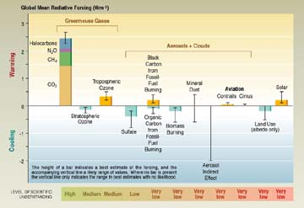
Atmospheric Carbon Budget

Slide 12
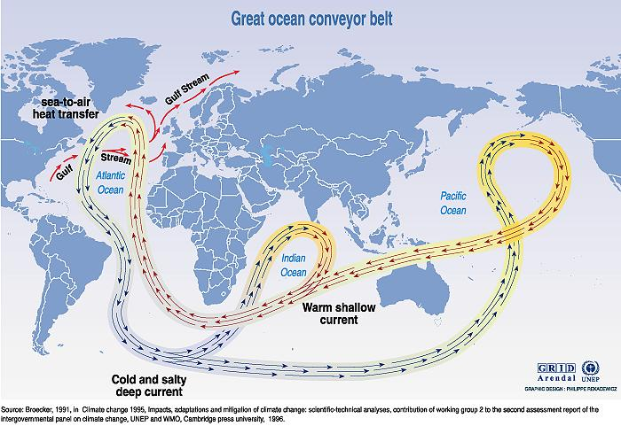
Worst Case Scenario

Slide 13
Changes in the Water Cycle
Warming will likely result in an increase in the amount of water exchanged among the oceans, atmosphere, and land.
Increasing rates of evaporation will likely result in drier soils.
An accelerated hydrologic cycle means greater amounts of precipitation in some areas and will probably result in more frequent and severe droughts and floods.

Slide 14
Flooding
In the early '90's, two 100-year floods occurred in less than 5 years in the Midwestern United States.
Significant changes in water volume, distribution, and supply are predicted and will likely have a dramatic impact on regional water resources.

Slide 15
Sea-level Rise
Increasing global temperatures causes the thermal expansion of sea water and the melting of icecaps which will result in rising sea level.
Sea level has risen 4 to 10 inches this century and is predicted to rise another 6 to 37 inches in the next century.
A doubling of pre-industrial CO2 concentration (550 ppm) is predicted to result in a sea level rise of greater than 40 inches.
A sea level rise of 80 inches is projected for an atmospheric CO2 concentration of 1100 ppm, a quadrupling of pre-industrial levels.

Slide 16
Biosphere
Climate change is predicted to alter water temperatures, flow regimes, and levels.
Such changes will likely cause an increase in biological productivity at high latitudes, but may result in extinctions for low latitude, cool and cold water species.
Increased variability in flow, which will result if the frequency and duration of large floods and droughts increases, will tend to reduce water quality, biological productivity, and the habitat in streams.

Slide 17
Coastlines
Sea level rise increases the vulnerability of coastal populations to flooding and causes land to be lost to erosion.
There are currently 46 million people around the world who are at risk due to flooding from storm surges.
With a 50 cm sea level rise (approx. one and ½ feet), that number will increase to 92 million.
Raise sea level 1 meter (about 3 feet) and the number of vulnerable people becomes 118 million.

Slide 18
Glaciers
In the next 100 years between one third and one half of the world's mountain glaciers could melt, affecting the water supply to rivers and thus hydroelectric dams and agriculture.
As is already being observed in Alaska, the areal extent and depth of permafrost are projected to decline, resulting in adverse effects on human infrastructure.
A decrease in the extent and thickness of sea-ice will likely improve the navigability of the Arctic Ocean.

Slide 19
Impact on Humans

Slide 20
Disease
As a result of warming, the area of the earth's surface experiencing "killing" frosts will probably decline.
As a result, there will likely be an increase in the geographical range of vector-borne (e.g. mosquito carried) diseases such as malaria, dengue, yellow fever, and encephalitis.
Currently, 45% of the world's population is within the zone of potential malaria transmission.
With predicted temperature increases, there will likely be an additional 50 to 80 million cases of malaria worldwide, bringing the percentage of the world's people within the susceptible zone to 60%.

Slide 21
Extreme Weather
The change in the frequency and intensity of extreme weather events (e.g. floods and droughts) combined with warmer atmospheric temperatures, will probably result in a host of adverse health effects, among them, exposure to contaminated water supplies and death from diseases.

Slide 22
Air Quality
It is also likely that increasing temperatures will result in a decline in air quality due to increases in the abundance of air pollutants, pollen, and mold spores.
An increase in the number of cases of respiratory disease, asthma, and allergies is likely to follow.

Slide 23
Most of the increase in atmospheric CO2 concentrations came from and will continue to come from the use of fossil fuels (coal, oil, and natural gas) for energy, but about 25% of the increase over the last 150 years came from changes in land use, for example, the clearing of forests and the cultivation of soils for food production.
From Richard Houghton, Senior Scientist, Carbon Research, Woods Hole Oceanographic Institute

Slide 24
Climate Shifts
Warming temperatures will probably induce a shift in the distribution of vegetation to higher elevations.
Living creatures that exist only at high elevations will possibly become extinct due to the disappearance of habitat or the decline in migration potential.
Recreational industries (e.g. ski industry) are likely to be disrupted, having a severe adverse effect on the economies of some regions.
The high elevation populations of developing nations will probably suffer from a decline in the abundance of food and fuel.

Slide 25
Biodiversity
Both plant and animal species are sensitive to climate.
Due to global warming, ideal temperature and precipitation ranges suitable for present life forms may shift dramatically and rapidly, more rapidly than the species that depend upon them can adapt to naturally.
Increased levels of carbon dioxide in the atmosphere may result in a decline in food values of grasses for herbivores.
A decline in biodiversity and in the goods and services provided by most ecosystems is a likely result.

Slide 26
Ecological Balance
Within the next 100 years many forest species may be forced to migrate between 100 and 340 miles in the direction of the poles.
The upper end of this range is a distance typically covered by migrating forests in millennia, not in decades.
A decline in species composition is predicted and some forest types may disappear from the earth, while new ones may be established.

Slide 27
Desertification
Desert regions are likely to be more extreme, becoming even hotter than they are presently.
The process of desertification will be more likely to become irreversible due to drier soils and land degradation through erosion and compaction.

Slide 28
Wetlands
Climate change and sea level rise, or changes in storms or storm surges could cause the erosion of shores and associated habitat, an increase in the salinity of estuaries and freshwater aquifers, a change in tidal ranges in rivers and bays, a change in sediment and nutrient transport, a change in the pattern of chemical and microbiological contamination in coastal areas, and an increase in coastal flooding.
The ecosystems at risk are salt water marshes, mangrove ecosystems, coastal wetlands, coral reefs, coral atolls, and river deltas.

Slide 29
Oceans
Changing atmospheric temperatures will change patterns of ocean circulation, vertical mixing, wave climate, and quantities of sea-ice cover.
These changes will affect nutrient availability, biological productivity, and the structure and function of marine ecosystems.
Paleoclimate (past climate) data and models show that major changes in ocean circulation can be caused by freshwater additions to the oceans from the movement and melting of sea ice or ice sheets and can result in rapid and dramatic changes in climate.

Slide 30
Agriculture
Rising temperatures are not predicted to change the global average production; however, significant regional changes are likely.
Production is projected to increase in high latitudes, in freshwater and from aquaculture.
Warmer climates should increase the growing season, decrease natural winter variability, and improve growing rates in high latitude regions.
However, these beneficial results may be counterbalanced by changes in reproductive patterns, migration routes, and ecosystem relationships.

Slide 31
Agriculture
Total global food production is not expected to change substantially as a result of climate change, but production will probably change dramatically regionally.
Some areas will have increasing crop yields. Others will decline, especially in tropical and subtropical regions. The flexibility in crop distribution (the variety of crops that can be grown in a region) is predicted to decline.
Developed countries may be able to adapt to these circumstances. Developing countries that currently struggle with these issues will suffer even more.

Slide 32
Civilization
Abrupt shifts in climate have had adverse effects on human civilizations in the past.
Paleoclimate data suggest that the collapse of the Mesopotamian Empire about 4,200 years ago (2,200 BC) corresponds to a sharp cooling event (Alley & deMenocal, 1998).

Slide 33
Responding to Climate Change Predictions
Humans will either mitigate the problem by reduction of greenhouse gas emissions or adapt by changing their life style.
Other species will not have a choice. They cannot mitigate the problem and they cannot easily change their life style.
It may be that the ultimate losers in the climate debate will not be us but rather all of our fellow travelers.
40

Slide 34
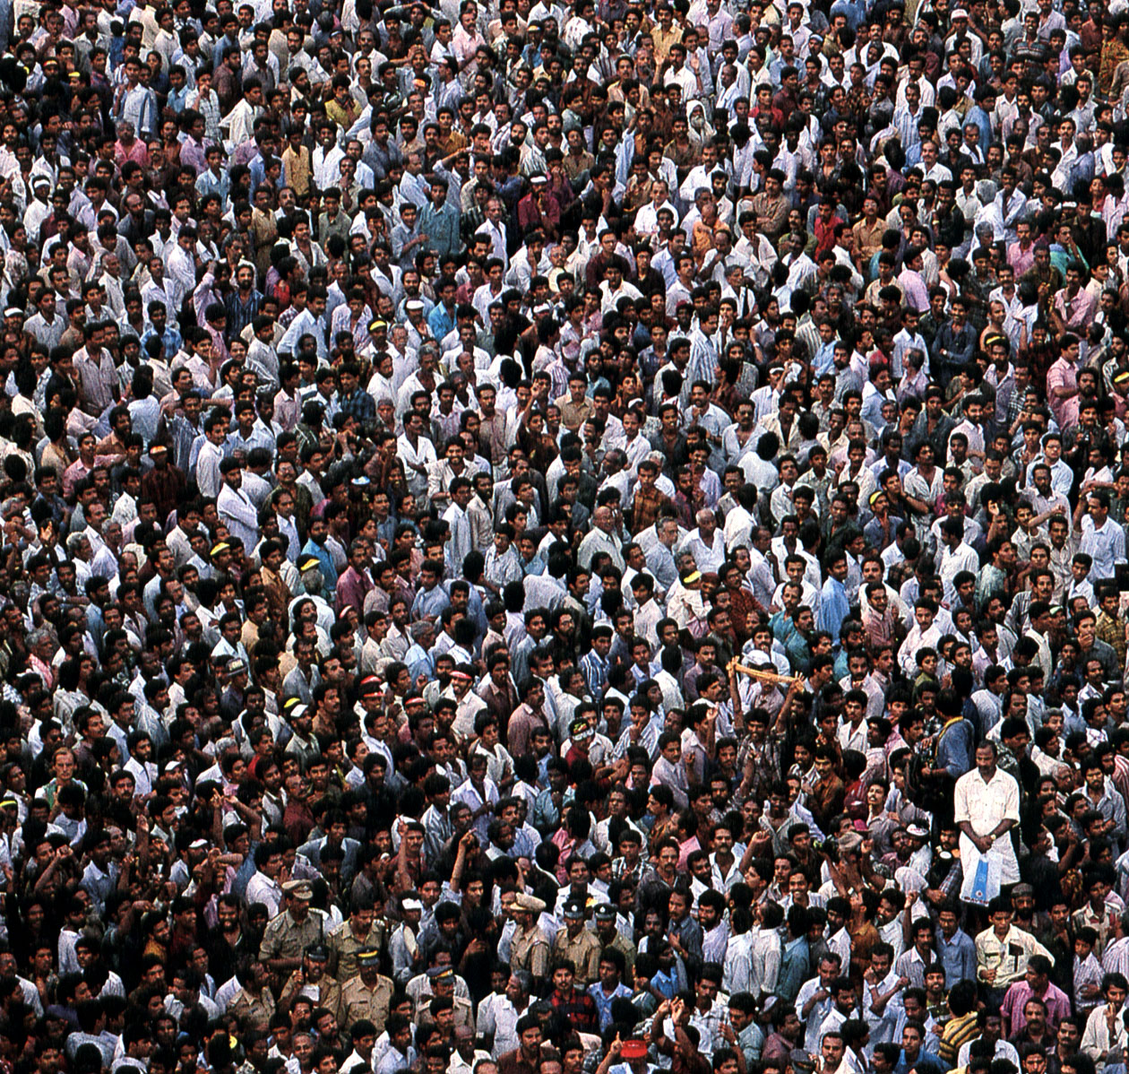
What is your choice of action?

