Slide 1
NS3310 - Physical Science Studies
Evolution

Slide 2
Caminalcules

Slide 3
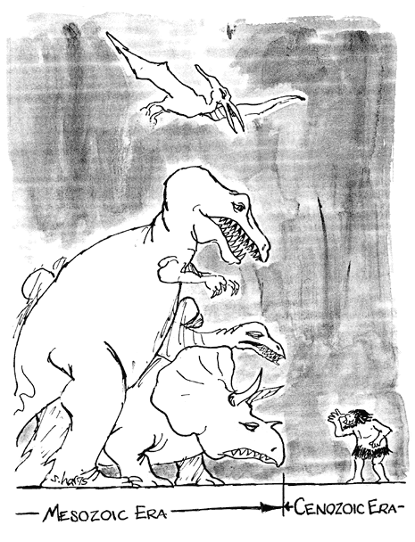
Key Questions
What is the history of life on earth?
How has life evolved?
What is the theory of Evolution?
What are the facts?
How does this relate to earth’s history?

Slide 4
Historical Perspective
Plato
Plato’s Ideal
Aristotle
Scala naturae
Future Causes
The Chain of Being

Slide 5
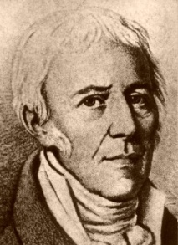
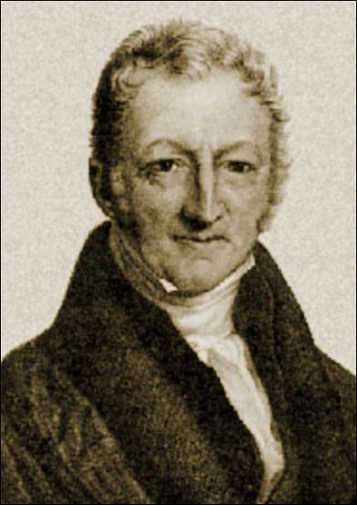
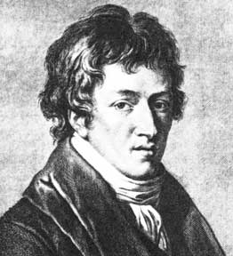
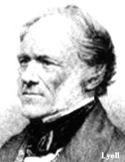
The Long Road to Recovery
Linnaeus
taxonomy
Hutton
gradualism
Lamarck
evolution
Malthus
populations
Cuvier
extinction
Lyell
uniformitarianism

Slide 6
Darwin
Voyage of the Beagle
Origin of Species
Wallace
Natural Selection
Mendel

Slide 7
Natural Selection and Adaptation
Species Fecundity
Stable Populations
Environmental Resources are Limited
Struggle for Survival
Variation within Populations
Differential Survivability
Successful Traits Accumulate

Slide 8
Patterns of Evolution
Homology
Vestigial Traits
Biogeography
The Fossil Record

Slide 9
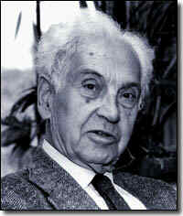
Modern Synthesis
Theodosius Dobzhansky
Sewell Wright
Watson and Crick
Ernst Mayr

Slide 10
Population Genetics
Population
Gene Pool
Hardy-Weinberg Equilibrium
p² + 2pq + q² = 1

Slide 11
Microevolution
Natural Selection
Genetic Drift
Bottleneck Effect
Founder Effect
Mutation

Slide 12
Variation
Variation Within Populations
Polymorphism
Gene diversity
Nucleotide diversity
Variation Between Populations
Geographic variation
Sexual recombination

Slide 13
Fitness
Optima
Relative Fitness
Selection
Directional selection
Diversifying selection
Stabilizing selection

Slide 14
Level of Selection
Gene selection
Species selection
Population selection

Slide 15
Sexual Selection
Sexual dimorphism
Mate Choice
Competition
The Ant and the Peacock

Slide 16
Perfection
Evolution is limited by history
Adaptations is limited by survivability
There are no future causes
Chance happens
Not all change is good

Slide 17
Macroevolution
Biological Species Concept
Ecological Species Concept
Pluralistic Species Concept
Morphological Species Concept
Genealogical Species Concept

Slide 18
Prezygotic Isolation
Habitat isolation
Behavioral isolation
Temporal isolation
Mechanical isolation
Gametic isolation

Slide 19
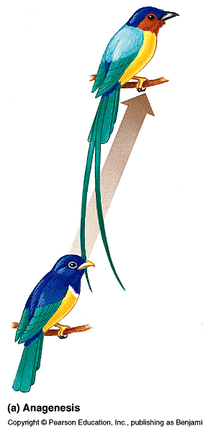
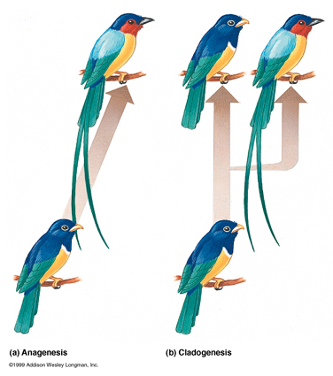
Speciation
Allopatric Speciation
Anagenesis
Sympatic Speciation
Cladogenesis

Slide 20
Examples of Speciation
Ring Species
Adaptive Radiation on Island Chains

Slide 21
Rates of Speciation
Gradualism
Catastrophism
Punctuated Equilibrium

Slide 22
Humans

Slide 23
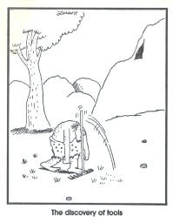
To Be Human
Brain Size
Jaw Shape
Bipedal Posture
Reduced Dimorphism
Social Structure

Slide 24
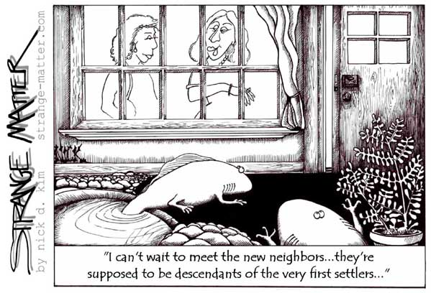
Key Concepts
Life has evolved.
Adaptations occur through natural
selection.
Variation of traits allows for adaptation.
Variation is maintained through sexual reproduction, genetic drift, mutation and other factors.
New species can arise as changes in traits due to adaptations accumulate.
The tree of life shows the history of evolution.
The theory of evolution is the unifying theory of biology.
“Nothing in biology makes sense without Evolution.”
Theodosius Dobszhansky

